Slide 1

Customer Lifetime Value Prediction
Springboard Data Science Career Track
Amy Zhao

Slide 2
The Problem
Our Goal
Historical customer lifetime value (LTV) fails to provide insights on the future lifetime value of the customers.
Build a supervised classification machine learning model and a regression machine learning model to predict customers’ LTVs based on their shopping behavior.

Slide 3
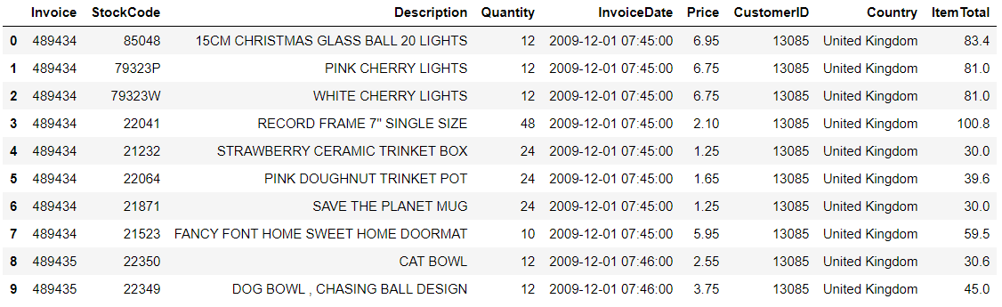
The Data
About the business:
UK-based online retailer – non-contractual
Unique all-occasion gifts
Many customers are wholesalers
Time period: 12/01/2009 - 12/09/2011
Number of records: 1,067,371
Number of fields: 8
Source: UCI Machine Learning Repository
Notes:
The variables include:
Invoice - ID unique to each transaction. If this code starts with the letter 'c', it indicates a cancellation.
StockCode - ID unique to each product.
Description - Product name.
Quantity - The quantities of each product per transaction.
InvoiceDate - Invoice date and time.
UnitPrice - Product price per unit in sterling (£).
CustomerID - ID unique to each customer
Country - The name of the country where a customer resides.

Slide 4
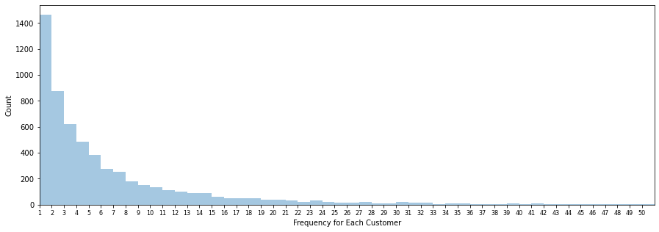
Exploratary Data Analysis
Number of orders
by each customer
Frequency
Classification Model
Regression Model
(Repeat Purchases)
Notes:
Frequency is a feature we use for both the classification model and the regression model
Regression model calculates the repeat purchases as the frequency, starts from 0
We see that many of the customers have engaged in a single transaction. The distribution of the count of repeat purchases declines from there in a manner that we may describe as negative binomial distribution.

Slide 5
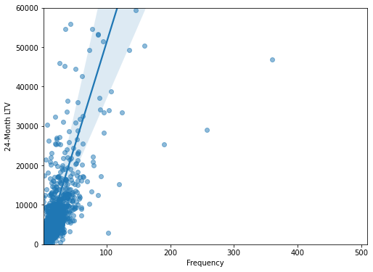
Exploratary Data Analysis
Frequency vs 24-Month Customer LTV
Notes:
Scatter plot with fitted linear regression model. There’s a slight correlation, eventhough a little difficult to tell.

Slide 6
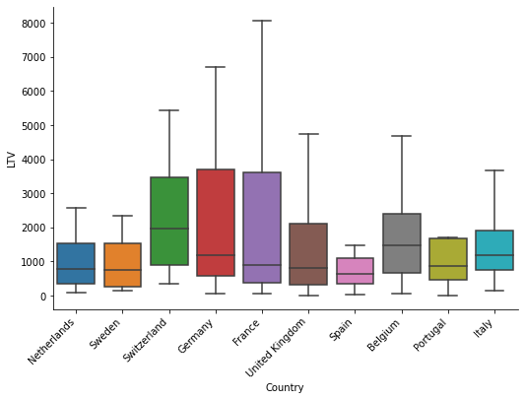
Exploratary Data Analysis
Customer LTVs Grouped by Countries
Notes:
Sorted by the mean customer LTV from left to right in descending order
We don’t see any obvious paterns from the plots.

Slide 7
Classification Model
Recency
Recency Score
RFM Score
Features
Frequency
Frequency Score
Monetary Value
Monetary Value Score
Country
0 – Low LTV
Label
21-Month LTV
1 – Mid LTV
2 – High LTV
Notes:
Use 3-month data for training, and predicting 21-month LTV

Slide 8
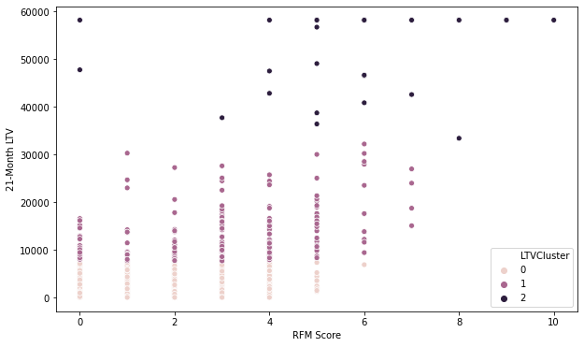
Classification Model
RFM Score
vs 21-Month LTV
vs LTV Segment
Notes:
We can observe correlation between the RFM score and the LTV segment from the scatter plot.
Highly imbalanced dataset

Slide 9
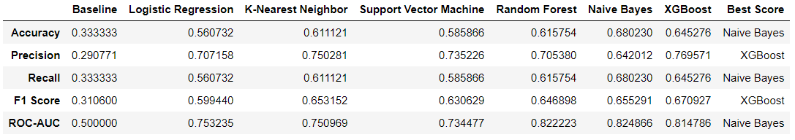
Classification Model – Model Selection
Naïve Bayes and XGBoost models were selected for further evaluation based on:
Balanced accuracy
Macro-averaged precision, recall, F1
ROC-AUC using OvO scheme
Notes:
Make sure that all classes contribute equally to the score
From the model performance comparison table, we can see that Gaussian Naive Bayes and XGBoost models are more effective than the rest

Slide 10
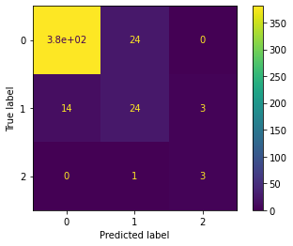
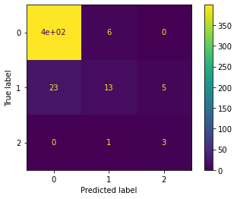
Classification Model – Model Selection
Gaussian Naive Bayes model was selected as the final model:
Both models successfully identified 75% of the actual high LTV (label 2) customers
Naive Bayes did a better job identifying mid LTV (label 1) customers
Naïve Bayes Confusion Matrix
XGBoost Confusion Matrix

Slide 11
Add more data to the model if possible
Add more features and improve feature engineering
Adopt different techniques for imbalanced datasets:
Under-sampling
Over-sampling
Weighting
Classification Model
– Future Improvements
Notes:
The models performed poorly on mid-LTV segment

Slide 12
Regression Model
BG/NBD Model
Number of Repeat Purchases
Lifetimes Package
Customer LTV
Gamma-Gamma Model
Average Order Value
Transactional Data
Recency
Frequency
Monetary Value
T
Features
Notes:
We used lifetimes to build two models. These two models together allowed us to predict customer LTVs from transactional data
We are still going to use RFM as the features, but this time using a built-in function from lifetimes package to transform the dataset into the features we need.
T represents the age of the customer. This is equal to the duration between a customer’s first purchase and the end of the period under study.

Slide 13
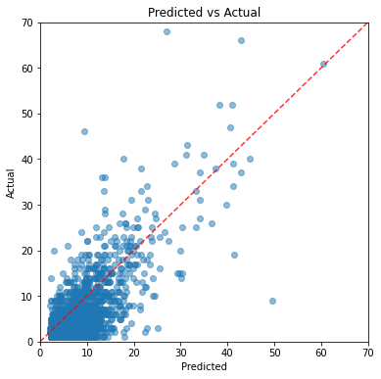
Regression Model
BG/NBD Model Performance Evaluation
Predicted Repeat Purchases vs Actual Repeat Purchases
Notes:
We visualize the relationships between some actual and predicted values. We can see that the predictions are decent from the scatter plot

Slide 14
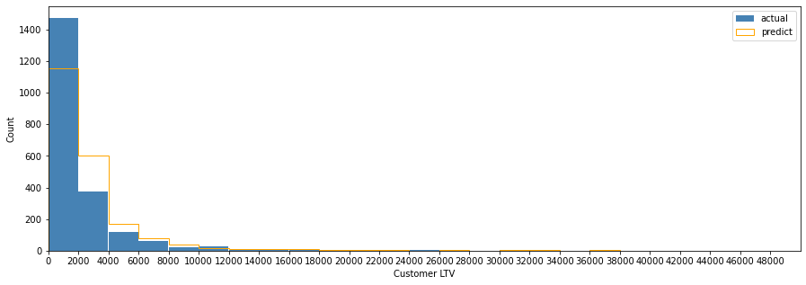
Regression Model
Overall Model Performance Evaluation
Distributions of Predicted vs Actual Customer LTVs
Notes:
We can also inspect how well does the distribution of the predicted customer LTVs align with that of the actual values.
The model underpredicts the occurrences of the lower customer LTVs

Slide 15
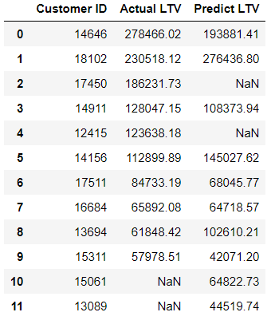
Regression Model – Model Evaluation
The model was able to capture the majority of the top 10 most valued customers, and only mispredicted 2 customers.
Top 10 Actual vs Predicted Most Valued Customer
Notes:
Overall this model takes a few simple features, and is quite accurate when we look at the aggregated level.

Slide 16
Fit the model on customer cohorts:
Split by country
Join the model with a linear model with additional features:
Website visits
Product reviews
Channel of acquisition
Demographic information
Regression Model
– Future Improvements

Slide 17
Thank You!

